Slide 1

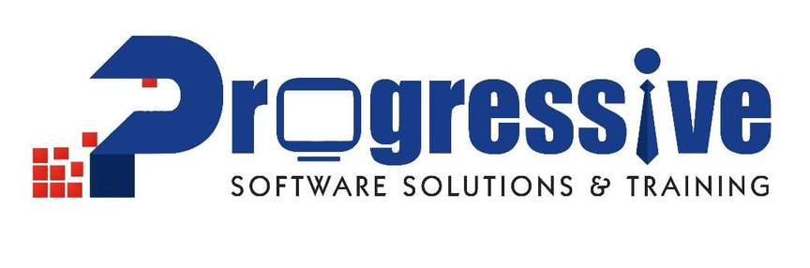

Progressive talks
MongoDB : Unraveling the NoSQL Database
#inspire.instill.learn

Slide 2

Table of Contents
What is Databases ?
Importance of databases in modern applications.
Points for discussion
Types of databases: SQL vs. NoSQL.
What is MongoDB?
History and evolution.
#inspire.instill.learn

Slide 3
Table of Contents
History and evolution.
Why MongoDB? Advantages over traditional databases.
Points for discussion
Types of databases: SQL vs. NoSQL.
Document-based storage.
Collections and documents.
#inspire.instill.learn

Slide 4
Table of Contents
JSON/BSON format.
What is mongodDB atlas
Points for discussion
How to create atlas account?
Deploying a free cluster on MongoDB atlas
Manage database users for your cluster.
#inspire.instill.learn

Slide 5
Table of Contents
Manage the IP access list.
Connect to your cluster.
Points for discussion
Insert and view a document.
hgfghf
hjfhjf
#inspire.instill.learn

Slide 6
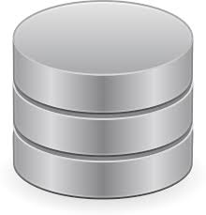
What is Databases ?
A database is an organized collection of data, typically stored and accessed electronically from a computer system. Databases are designed to manage large amounts of information efficiently by allowing data to be easily retrieved, inserted, updated, and deleted. They are essential components of most software applications, including web applications, and are used in various industries for different purposes, such as storing customer information, inventory management, financial transactions, and more.
#inspire.instill.learn

Slide 7
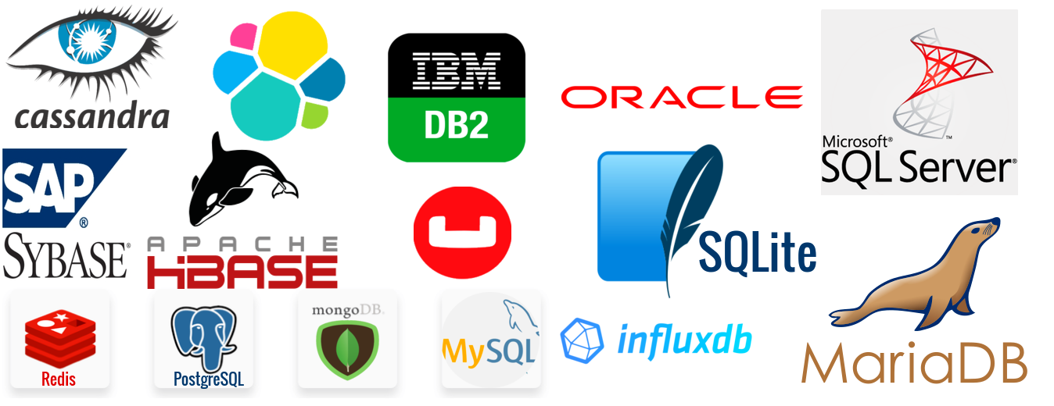
Importance of databases in modern applications.
Data Storage: Databases provide a structured and efficient way to store data persistently. This ensures that the data remains available even after the application shuts down or restarts.
Data Retrieval: Databases enable efficient retrieval of data based on various criteria. This allows applications to quickly fetch the required information and present it to users.
Data Integrity: Databases offer mechanisms to enforce data integrity constraints such as unique keys, foreign keys, and data validation rules. This ensures that the data remains consistent and accurate over time.
#inspire.instill.learn

Slide 8
Importance of databases in modern applications.
Scalability: Modern databases are designed to scale horizontally or vertically to handle increasing amounts of data and user requests. This scalability is essential for applications experiencing growth in user base or data volume.
Concurrency Control: Databases support concurrency control mechanisms to manage simultaneous access to data by multiple users or processes. This prevents data corruption and ensures that transactions are executed reliably.
#inspire.instill.learn

Slide 9
Importance of databases in modern applications.
Security: Databases provide features for authentication, authorization, and encryption to protect sensitive data from unauthorized access or tampering. This helps in maintaining the confidentiality and integrity of the data.
Data Analysis: Databases often come with built-in support for querying and analyzing data, enabling applications to derive insights and make data-driven decisions.
#inspire.instill.learn

Slide 10


Types of databases: SQL vs. NoSQL.
SQL (Structured Query Language) and NoSQL (Not Only SQL) are two broad categories of databases, each with its own characteristics, advantages, and use cases.
#inspire.instill.learn

Slide 11
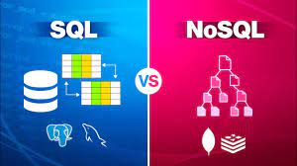
Types of databases: SQL vs. NoSQL.
SQL (Structured Query Language) and NoSQL (Not Only SQL) are two broad categories of databases, each with its own characteristics, advantages, and use cases.
#inspire.instill.learn

Slide 12
Types of databases: SQL vs. NoSQL.
SQL Databases:
Structured Data: SQL databases are based on a structured model where data is organized into tables, with predefined schemas specifying the types and relationships of data.
ACID Properties: They typically support ACID (Atomicity, Consistency, Isolation, Durability) properties, ensuring data integrity and reliability.
#inspire.instill.learn

Slide 13
Types of databases: SQL vs. NoSQL.
Schema-Based: SQL databases require a predefined schema, meaning the structure of the data must be defined before insertion.
Vertical Scalability: They are generally designed for vertical scalability, meaning you can scale up by adding more resources (like CPU or RAM) to a single server.
Examples: MySQL, PostgreSQL, SQLite, Oracle.
#inspire.instill.learn

Slide 14
Types of databases: SQL vs. NoSQL.
NoSQL Databases:
Flexible Data Model: NoSQL databases offer a more flexible data model, allowing for semi-structured or unstructured data.
Horizontal Scalability: They are typically designed for horizontal scalability, meaning you can scale out by adding more servers to a distributed system.
#inspire.instill.learn

Slide 15
Types of databases: SQL vs. NoSQL.
Schema-less: NoSQL databases do not require a predefined schema, allowing for easier and faster development with evolving data requirements.
Types: There are different types of NoSQL databases, including document-based (like MongoDB), key-value stores (like Redis), wide-column stores (like Cassandra), and graph databases (like Neo4j).
#inspire.instill.learn

Slide 16
Types of databases: SQL vs. NoSQL.
Performance: NoSQL databases often excel in handling large volumes of data and high throughput, making them suitable for big data and real-time applications.
Examples: MongoDB, Cassandra, Redis, Couchbase.
#inspire.instill.learn

Slide 17
Types of databases: SQL vs. NoSQL.
Use Cases:
SQL databases are often used for applications with complex queries, transactions, and structured data requirements, such as financial systems, e-commerce platforms, and traditional relational applications.
NoSQL databases are commonly chosen for applications with rapidly changing or unstructured data, as well as for big data, real-time analytics, and distributed systems.
#inspire.instill.learn

Slide 18
Types of databases: SQL vs. NoSQL.
Ultimately, the choice between SQL and NoSQL databases depends on factors like the specific requirements of your application, scalability needs, data structure, and development preferences.
#inspire.instill.learn

Slide 19
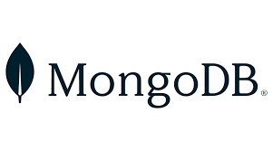
What is MongoDB?
MongoDB is a popular, open-source NoSQL database program. It falls under the category of document-oriented databases, meaning it stores data in flexible, JSON-like documents. MongoDB is designed to be scalable and flexible, making it suitable for a wide range of applications, from small startups to large enterprises.
Flexible Schema
Scalability
#inspire.instill.learn

Slide 20
What is MongoDB?
High Performance
Document Model
Rich Query Language
Replication and High Availability
Automatic Sharding
#inspire.instill.learn

Slide 21
Centralized App
Decentralized App
A single firm manages and owns a centralized program, which runs on a single server or cluster of servers.
Examples include- Google, Apple, Facebook, Amazon, Microsoft, Twitter, Instagram, Netflix, WhatsApp
Centralized Applications are less secure.
On a blockchain network, a decentralized app, or “dApp,” runs.
Examples include- Uniswap, CryptoKitties, Rarible, IDEX, MakerDAO, CryptoPunks, BitTorrent, Audius, and MetaMask
Decentralized Applications (dApps) are highly secure.
#inspire.instill.learn

Slide 22
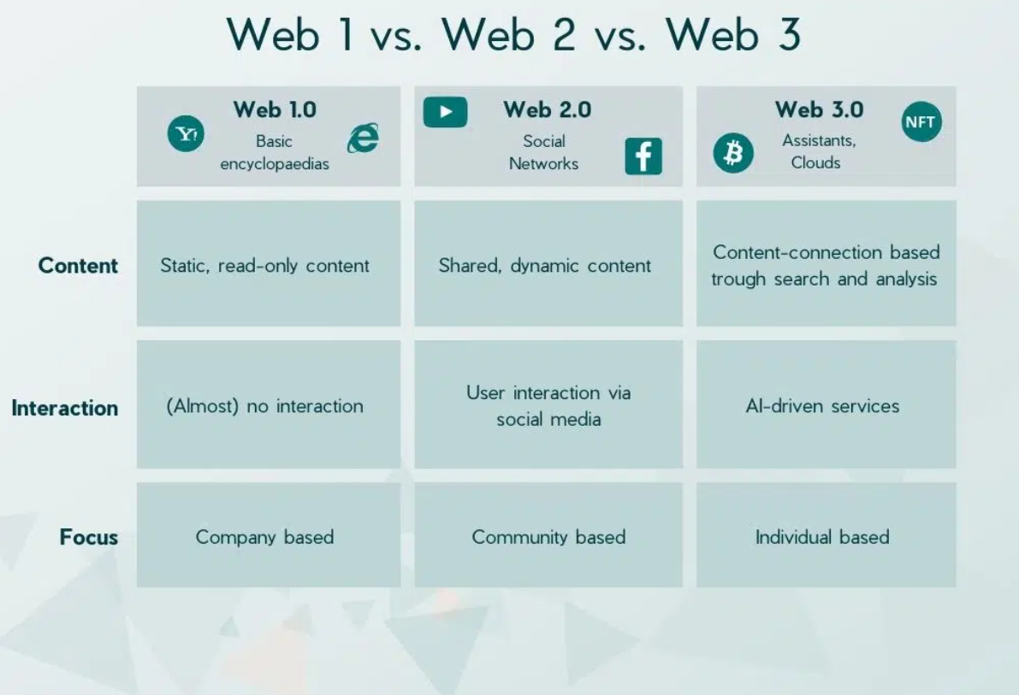
Web ?
#inspire.instill.learn

Slide 23
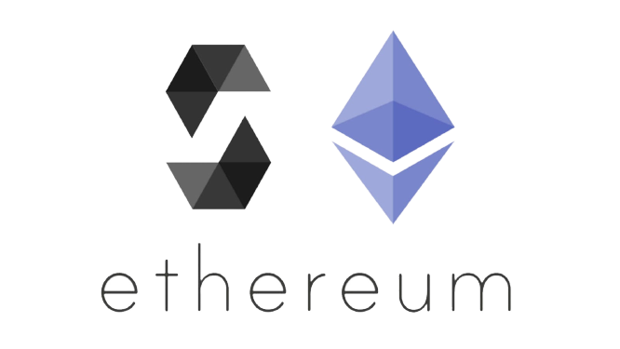
Solidity is an object-oriented programming language created specifically by the Ethereum Network team for constructing and designing smart contracts on Blockchain platforms.
It's used to create smart contracts that implement business logic and generate a chain of transaction records in the blockchain system.
It acts as a tool for creating machine-level code and compiling it on the Ethereum Virtual Machine (EVM).
It has a lot of similarities with C and C++ and is pretty simple to learn and understand. For example, a “main” in C is equivalent to a “contract” in Solidity.
Like other programming languages, Solidity programming also has variables, functions, classes, arithmetic operations, string manipulation, and many other concepts.
What is Solidity?
#inspire.instill.learn

Slide 24



The use of Smart Contract
Smart contracts are computer programs or protocols for automated transactions that are stored on a blockchain and run in response to meeting certain conditions. In other words, smart contracts automate the execution of agreements so that all participants can ascertain the outcome as soon as possible without the involvement of an intermediary or time delay.
Smart contracts are self-executing contracts in which the contents of the buyer-seller agreement are inscribed directly into lines of code.
According to Nick Szabo, an American computer scientist who devised a virtual currency called "Bit Gold" in 1998, Smart contracts are computerized transaction protocols that execute contract conditions.
Using it makes the transactions traceable, transparent, and irreversible.
#inspire.instill.learn

Slide 25
Visual Studio Code (IDE)
Node.js (for react)
Requirements
Metmask (Wallet)
Points for discussion
Ganache (for local transaction amount)
Solidity (for smart contract)
React (for client side)
#inspire.instill.learn

Slide 26

Visual Studio Code is a code editor redefined and optimized for building and debugging modern web and cloud applications.
Download the Visual Studio Code installer for Windows
Once it is downloaded, run the installer (VSCodeUserSetup-{version}.exe). This will only take a minute.
By default, VS Code is installed under C:\Users\{Username}\AppData\Local\Programs\Microsoft VS Code
VS Code
#inspire.instill.learn

Slide 27
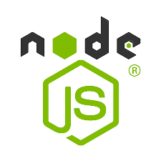
Node.js is an open source server environment; Node.js is free ; Node.js can generate dynamic page content;
Download the Windows Installer from NodeJs official website. Make sure you have downloaded the latest version of NodeJs. It includes the NPM package manager.
double-click to install .msi binary files to initiate the installation process. Then give access to run the application.
By clicking on the Next button, you will get a custom page setup on the screen. Make sure you choose npm package manager , not the default of Node.js runtime . This way, we can install Node and NPM simultaneously.
Node.js
#inspire.instill.learn

Slide 28

Let’s walk through the steps to install it on Google Chrome.
Step 1: Go to Chrome Web Store Extensions Section.
Step 2: Search MetaMask.
Step 3: Check the number of downloads to make sure that the legitimate MetaMask is being installed, as hackers might try to make clones of it.
Step 4: Click the Add to Chrome button.
Step 5: Once installation is complete this page will be displayed. Click on the Get Started button.
Step 6: This is the first time creating a wallet, so click the Create a Wallet button. If there is already a wallet then import the already created using the Import Wallet button.
Step 7: Click I Agree button to allow data to be collected to help improve MetaMask or else click the No Thanks button. The wallet can still be created even if the user will click on the No Thanks button.
Metamask
#inspire.instill.learn

Slide 29
Step 8: Create a password for your wallet. This password is to be entered every time the browser is launched and wants to use MetaMask. A new password needs to be created if chrome is uninstalled or if there is a switching of browsers. In that case, go through the Import Wallet button. This is because MetaMask stores the keys in the browser. Agree to Terms of Use.
Step 9: Click on the dark area which says Click here to reveal secret words to get your secret phrase.
Step 10: This is the most important step. Back up your secret phrase properly. Do not store your secret phrase on your computer. Please read everything on this screen until you understand it completely before proceeding. The secret phrase is the only way to access your wallet if you forget your password. Once done click the Next button.
Step 11: Click the buttons respective to the order of the words in your seed phrase. In other words, type the seed phrase using the button on the screen. If done correctly the Confirm button should turn blue.
Step 12: Click the Confirm button. Please follow the tips mentioned.
Step 13: One can see the balance and copy the address of the account by clicking on the Account 1 area.
Metamask
#inspire.instill.learn

Slide 30

Download Ganache from official website
Double-click on downloaded file
Follow the Steps for install
After installation Select new Workspace
Create a workspace a choose it
#inspire.instill.learn

Slide 31

Solidity is an object-oriented programming language for implementing smart contracts on various blockchain platforms, most notably, Ethereum. It was developed by Christian Reitwiessner, Alex Beregszaszi, and several former Ethereum core contributors. Programs in Solidity run on Ethereum Virtual Machine.
#inspire.instill.learn

Slide 32
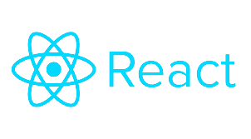
React is a JavaScript library developed by Facebook which, among other things, was used to build Instagram.com. Its aim is to allow developers to easily create fast user interfaces for websites and applications alike. The main concept of React. js is virtual DOM.
npx create-react-app my-app
cd my-app
npm start
#inspire.instill.learn

Slide 33






Do you have any questions?
#inspire.instill.learn

